Slide 1



Introduction to Council for Exceptional Children
Intervener Standards

Slide 2
Overview
Any method of credentialing or certification must have standards by which the individual applying for certification can be evaluated.
The standards used for the Intervener Microcredentials and NICE certification are the Council for Exceptional Children’s (CEC) Specialty Set: Special Education Paraeducator Intervener for Individuals With Deafblindness (PDBI). To make it simple we will call them “CEC Intervener Standards”.
This slide presentation is based on the 2022 version of the intervener CEC standards.

Slide 3
Have Your Handouts Ready!
The following slide deck will reference the following handouts:
CEC Intervener Standards and/or
CEC Standards for Note Taking

Slide 4
About CEC Intervener Standards
The CEC is a professional association of educators dedicated to advancing the success of children with disabilities or those who are gifted.
One of the organization's key roles is the development of national professional standards to help ensure that children receiving special education services are supported by well-prepared, career-oriented educators.
The Intervener Standards were first developed by experts in the field of deaf-blindness in 2016 and revised in 2022.
You will need to become very familiar with the CEC intervener standards while working on the requirements for Intervener microcredentials and NICE certification, so let’s take some time to go through them in detail.

Slide 5
CEC Intervener Standards
There are 7 standards and within each standard is a set of “knowledge” and “skill” competencies. The total number of competencies is 73.
Standard | Competencies
Engaging in Professional Learning and Practice within Ethical Guidelines | 10
Understanding and Addressing Each Individual’s Developmental and Learning Needs | 19
Demonstrating Subject Matter Content and Specialized Curricular Knowledge | 9
Using Assessment to Understand the Learner and the Learning Environment for Data-Based Decision Making | 2
Supporting Learning Using Effective Instruction | 19
Supporting Social, Emotional, and Behavioral Growth | 12
Collaborating with Team Members | 2

Slide 6
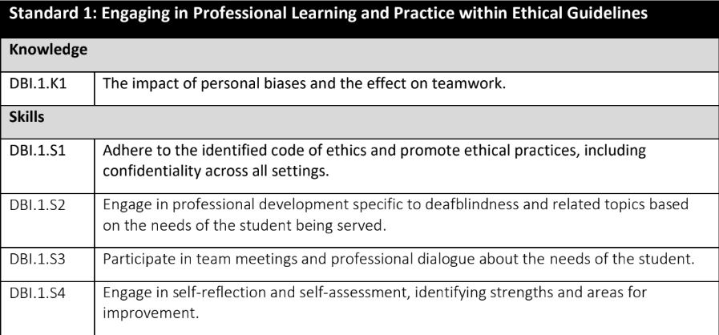
Breaking Down the Standards
Take a look at the copy of the complete set of standards that you downloaded before beginning this slide presentation.
This illustration shows the first 3 of 10 competencies under Standard 1. You can also review these in your CEC Intervener Standards Handout.

Slide 7
Breaking Down the Standards (cont.)
Let's look more closely at the code for the very first competency.
DBI stands for DeafBlind Intervener
The first number "1" tells you this competency is in Standard 1
The "K" indicates that it is a knowledge competency
The last "1" identifies it as the first knowledge competency within this standard

Slide 8
Breaking Down the Standards (cont.)
As you scan the first standard on your own copy, you will see that 1 competencies has a “K” code and 9 competencies have a "S" in the competency code.
This means that one is a knowledge competency and 9 are skill competencies.

Slide 9
Breaking Down the Standards (cont.)
Practice breaking down this code for yourself: DBI.6.S1

Slide 10
Breaking Down the Standards (cont.)
How did you do?
DBI.6.S1
DBI = DeafBlind Intervener (this will always be the same for every competency)
6 = Standard 6
S = a skill
1 = the first skill competency in this standard
Note: In NICE, we typically omit the “DBI” from the competency code. For example, you can use 6.S1 as shorthand for this competency.

Slide 11

Reflecting on the Standards (cont.)
Take a few moments to review the CEC Intervener Standards on your handout.
Which standards do you think will be the easiest for you to document?
Which ones do you anticipate being the most challenging?
Be sure to discuss any questions or concerns with your mentor.

Slide 12
Learn More About the CEC
For more information about the Council for Exceptional Children, visit their website at www.cec.sped.org
Be sure to check out the CEC Intervener Standards while you are there.

Slide 13

For more information on Intervener Microcredentials and NICE certification, contact Dr. Ritu Chopra at the PAR²A Center
Ritu.Chopra@ucdenver.edu
https://paracenter.org/
Adapted from NICE Training Materials, 2017–2024. U.S. Department of Education Grant #H326T180026

