Slide 1

Calendar Systems
Standard 3: Demonstrating Subject Matter Content and Specialized Curricular Knowledge
Candidate: Emily Jeffs
Mentor: Sarah Martin
June 2025

Slide 2
Competencies Addressed
List all competencies addressed by this artifact.
DBI.3.S2 Facilitate the use of calendar systems and other tools for transition and communication across educational environments.

Slide 3
Artifact Questions
What are the documentation formats (Delete all that do not apply)?
Photo work sample
Video work sample
In what settings was documentation depicting or related to a specific student collected (Delete all that do not apply)?
Classroom/school

Slide 4
Artifact Questions Continued
In what settings was the documentation involving assignments or other study generated (Delete all that do not apply)?
State deaf-blind project training
What level of collaboration was involved in activities depicted in the documentation (Delete all that do not apply)?
Team effort

Slide 5
Media Release
Do you have a Media Release for the individuals in this artifact?
Yes No

Slide 6
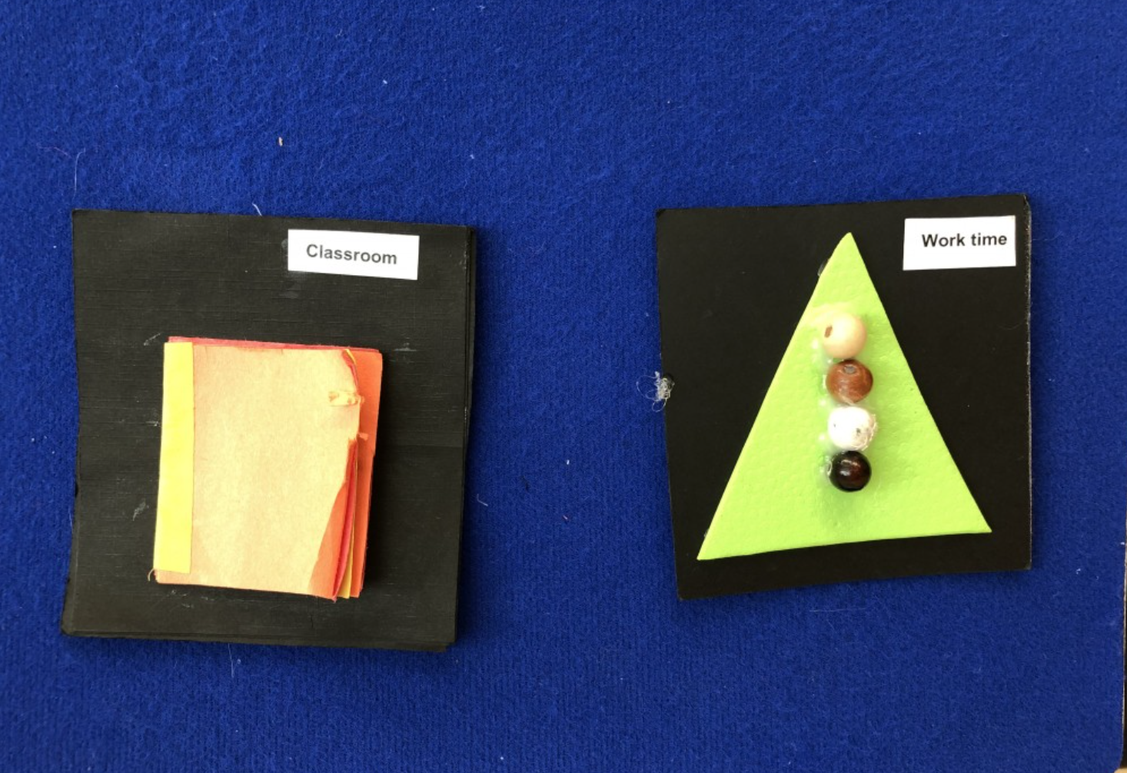
Documentation
Here is a video of my and my student* actively using her calendar system.
*Video is not provided in training materials to protect learner.

Slide 7
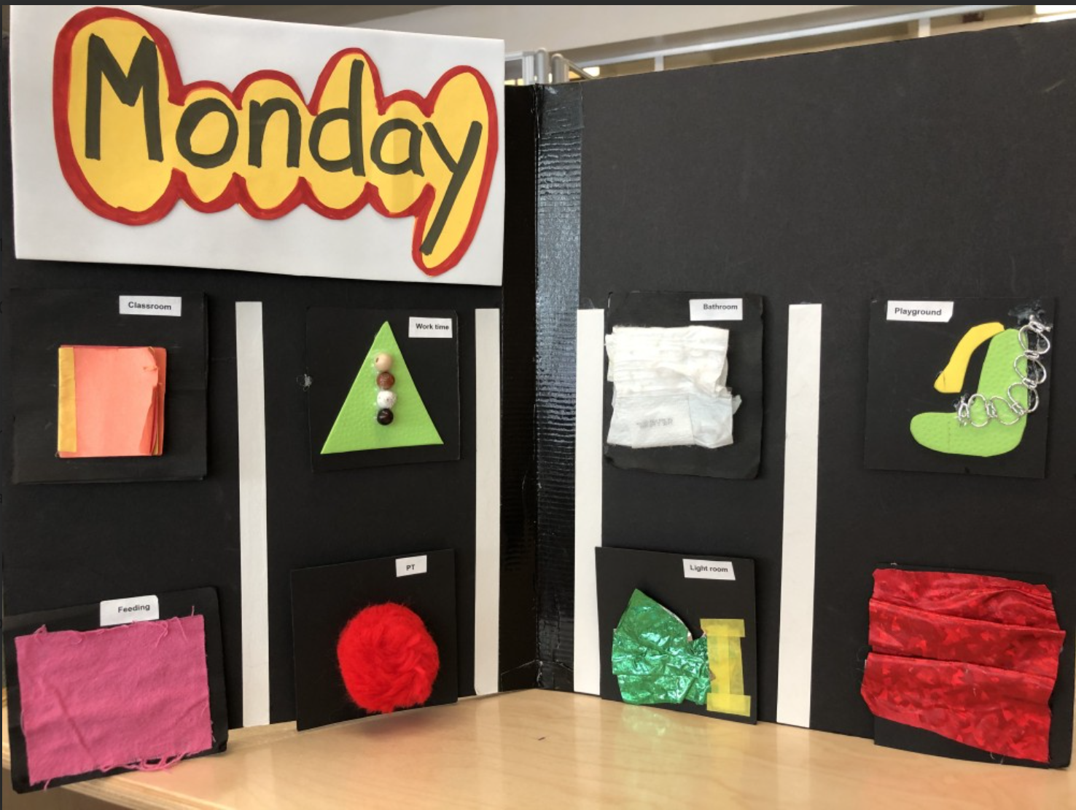
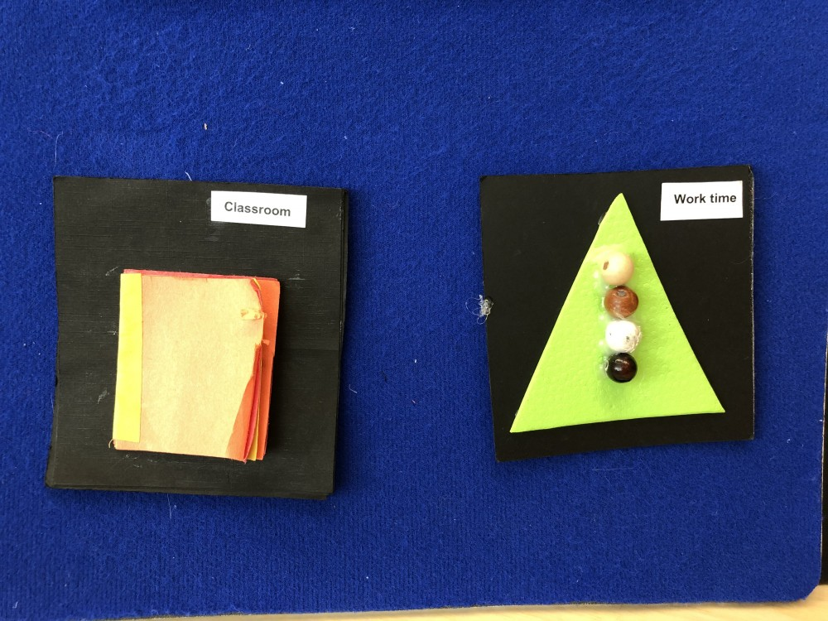
Documentation

Slide 8
Additional Information
This was created with help from the SLP. She gave me the materials to create it.

Slide 9
Explanation Question 1
Please list each competency and describe how you have demonstrated the specific knowledge or skill.
We use a big black calendar board in the classroom every morning that has 8 touchable symbols to show what’s happening that day. There’s also a smaller blue board we use during the day that shows what we’re doing now and what’s coming next. This helps Curls know what to expect and makes her feel more comfortable. The calendar also helps her learn ideas like what comes first, what’s next, and when something is finished. She’s starting to really get the routine when an activity is done, she takes off the symbol and touches the next one. That tells me she understands what’s going on.

Slide 10
Explanation Question 2
Describe and explain your documentation so your reviewer can understand it better. This is your opportunity to provide additional context for the documentation. Examples are: what are you doing with the client/student, what is the student doing, why did you select this documentation?
In the video and pictures I included, you’ll see how we use her calendar system throughout the day. When she arrives at school, we always start with the black tactile calendar. I sit with her and do everything hand-under-hand—showing her the date at the top, and going through each tactile cue so she can preview her schedule. Later in the day, when we leave the classroom, I bring the smaller blue board with us. It shows just two cues: what she’s doing now and what’s coming next. This helps her transition smoothly and builds her trust in what’s happening.

Slide 11
Explanation Question 2 Continued
We also use talking buttons during work time. These buttons play a teacher’s or therapist’s voice so Curls can recognize who she’ll be working with. That idea came from our vision teacher, and it’s been really helpful in helping her connect voices to people and prepare for who’s coming next.
All of these tools—the calendars, the cues, the buttons—give Curls more control and help reduce anxiety. If there’s a schedule change, I explain it using sign, spoken words, and a different tactile cue so she knows what’s going on. I’ve noticed that as long as I explain it clearly, she handles changes really well.
What’s made this whole process work is the collaboration with the team. The vision teacher helped me choose materials that feel different enough for Curls to recognize by touch, and I’ve been learning how to adapt as her understanding grows. It’s also been great to see how the whole team waits and gives me time to review the schedule with her before each activity. That consistency is key.
Honestly, using the calendar system has changed how I work as an intervener. I’ve realized how powerful it is to help a student feel safe and informed just by giving them a clear way to understand their day. It’s kind of like how I need my own calendar to get through a busy day—Curls needs hers, too. And now, thanks to the training and teamwork, she has it.

