Slide 1



Developing Artifacts for Your Microcredential Portfolio

Slide 2
Have Your Handouts Handy!
This slide deck references the following handouts:
Documentation Information and Formats
Explanation and Submission Prompts

Slide 3
Developing Artifacts
While constructing artifacts and reviewing them can be cumbersome, they capture the complexities of professional practice in ways that no other approach can.
Adapted from Frederick D. Smith.
Source: Wolf, 1996 p. 34

Slide 4
Artifacts
Artifacts are items you create to showcase what you know and can do. They demonstrate your mastery of the knowledge and skills outlined in the CEC Standards.
Each individual artifact contains the following three components:
A list of selected knowledge and skill competencies from the CEC Intervener Standards
One or more pieces of documentation or evidence that show you have mastered those competencies
An explanation of how the documentation supports the competencies

Slide 5
Steps in Developing Artifacts
While you'll ultimately build your artifacts on your computer, much of the real work happens offline. The main steps include:
Determine how your training and work experience align with the competencies
Identify or create documentation that Demonstrates each competency
Write an explanation of how your documentation demonstrates mastery of the competencies
Each of these steps requires thoughtful self-reflection.
Let’s look at an example...

Slide 6
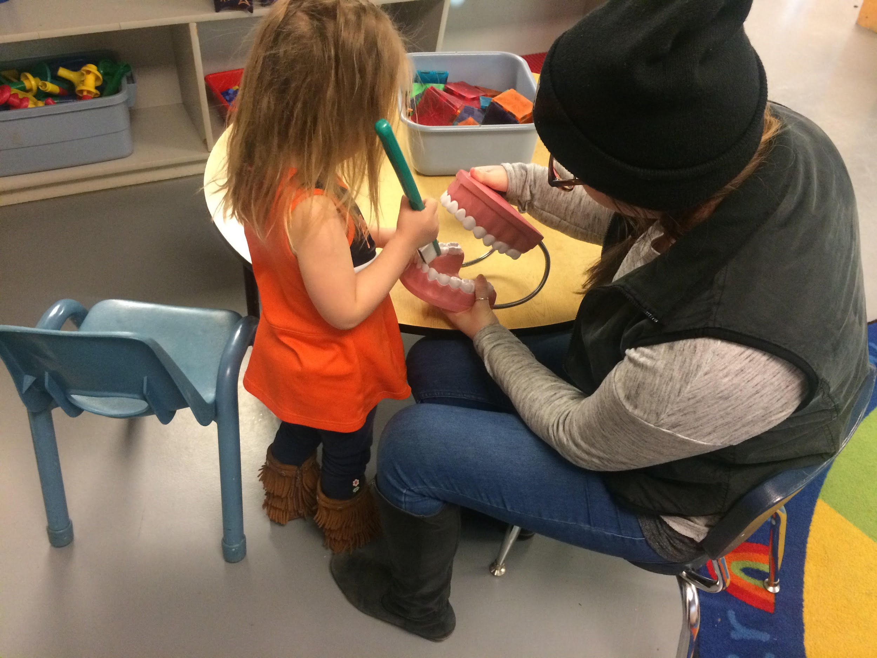
Step 1 of Artifact Development: Example
Step 1: Determine How Your Training and Experience Align with the Competencies
Irene is an intervener working with a 6-year-old girl named Primrose in a general education classroom. After reflecting on her daily responsibilities and discussing them with her mentor, Irene recognizes that the strategies she uses to support Primrose’s meaningful participation in science lessons clearly demonstrate her strengths in the following skills from Standard 5:
DBI 5.S3 Provide 1:1 intervention varying the level and intensity of input to reinforce and support student engagement, self-regulation, and learning.
DBI.5.S5 Use routines and functional activities as learning opportunities.

Slide 7
Step 2 of Artifact Development: Example
Step 2: Identify or Create Documentation(e.g., videos, photos, assignments)
Irene decides that a video clip will be an essential piece of documentation to showcase all three of the selected skills. She arranges for a co-worker to record her working with Primrose during a typical science lesson.
She also includes a copy of an activity routine sheet that she and Primrose’s Grade VI teacher developed, which provides additional support for the second skill on the list: using routines and functional activities as learning opportunities.

Slide 8

Step 3 of Artifact Development: Example
Step 3: Write an Explanation of How Your Documentation Demonstrates Mastery of the Competencies
In this step, you'll reflect on each piece of documentation you've selected and explain how it illustrates your knowledge and skills. Clearly connect your artifacts to the specific competencies they represent, highlighting why each one is a strong example of your mastery.

Slide 9
Step 3: Example (contd.)
Irene’s explanation will describe how the video supports all three listed competencies, while the activity routine form provides additional evidence for the second competency.
Artifact Title: Primrose’s Science Lesson
Documentation | Competencies Targeted in This Artifact
Video clip (also known as a “Video Work Sample”) | Provide one-on-one intervention
Activity routine form (a type of “Written Work Sample”) | Use routines and functional activities as learning opportunities
 | Facilitate direct learning experiences

Slide 10
Naming Artifacts
You may have noticed on the previous slide that Irene titled this artifact “Primrose’s Science Lesson.”
It’s important to give artifacts specific titles to help you stay organized. The actual name isn’t important, but it should be something meaningful that helps you distinguish this artifact from others as your collection grows.
An alternative to using relevant keywords as a title is to name artifacts according to the competencies they address. For example, Irene could have named this artifact “5.S1_5.S2_5.S3” to indicate that it addresses the first, second, and third skill competencies in Standard 5.
Choose a naming system that makes sense to you, and use it consistently.

Slide 11
More About Artifact Components
In the remainder of this presentation, we will go through each of three components of an artifact in more detail:
Competencies
Documentation
Explanations

Slide 12
More About Artifact Components (cont.)
As you read through these slides, we hope you’ll see that you have a lot of flexibility in creating artifacts.
You can define your own goals—consider each micro-credential and how many competencies you need to address. There’s plenty of room for individual expression in the types of documentation you choose and how you explain their significance.
Every candidate’s work is a unique reflection of their experiences and personality.

Slide 13
Artifact Component 1:
Competencies

Slide 14
Artifact Component 1: Competencies
As you review the competencies, it will be helpful to categorize them as ones you address:
Daily
Occasionally
Rarely
This will give you an idea of how easy or difficult it will be to find supporting documentation. It may take more time to locate appropriate documentation for competencies you rarely use in your daily work.
This type of strategic thinking will help you plan the most efficient path forward as you begin collecting documentation.

Slide 15
Artifact Component 1:Competencies (cont.)
As you develop artifacts, you will cluster related competencies together.
For example, you might choose to address the following competencies in one artifact because they all relate to basic knowledge about deaf-blindness:
DBI.2.S1 Use and maintain amplification, cochlear implants, and assistive listening devices as directed
DBI.2.S2 Use and maintain glasses, low vision devices, and prostheses as directed
DBI.2.S3 Maximize the use of residual vision, hearing, and touch across multiple environments

Slide 16
Artifact Component 1:Competencies (cont.)
How you cluster the competencies will depend on the types of documentation you have available and what makes sense to you, but there are three rules:
You may not include more than 5 competencies in a single artifact.
  Your submission will be returned if you include more than five competencies in any artifacts.
  Helpful Tip: Artifacts score higher when fewer competencies are addressed
All competencies in a single artifact must come from the same standard.

Slide 17
Artifact Component 1:Competencies (cont.)
The artifacts for each standard must cover all the competencies within that standard. For example, since Standard 3 contains 9 competencies, you will need at least two artifacts.
.
Standard | Number of Competencies | # Artifacts
Standard 1: Engaging in Professional Learning and Practice within Ethical Guidelines | 10 | 2 or more
Standard 2: Understanding and Addressing Each Individual’s Developmental and Learning Needs | 19 | 4 or more
Standard 3: Demonstrating Subject Matter Content and Specialized Curricular Knowledge | 9 | 2 or more
Standard 4: Using Assessment to Understand the Learner and the Learning Environment for Data-Based Decision Making | 2 | 1 or more
Standard 5: Supporting Learning Using Effective Instruction | 19 | 4 or more
Standard 6: Supporting Social, Emotional, and Behavioral Growth | 12 | 3 or more
Standard 7: Collaborating with Team Members | 2 | 1 or more

Slide 18
Artifact Component 2:
Documentation

Slide 19

Documentation
Documentation refers to materials from your work or training activities that support the knowledge and skill competencies in the CEC standards. Each artifact must contain one or more pieces of documentation.
There are 8 different types of documentation that you can use:
Photo work samples (multiple photos of a skill
Video work samples
Written work samples
Completed coursework assignments
Professional development products
Self-study products
Performance evaluations
Reports of formal observations of the intervener
Note: Documentation Information and Formats defines the types of documentation.

Slide 20
Work Samples
Work samples, as the name implies, are photos, videos, or written items from your work. Because they are typically related to interactions with a specific individual they are likely to be helpful in demonstrating both knowledge and skill competencies.
As often as possible, these should be from real-life situations rather than role-playing activities (see Documentation Information and Formats for details about when role-playing is acceptable).
Photo work samples
Video work samples
Written work samples
Completed coursework assignments
Professional development products
Self-study products
Performance evaluations
Reports of formal observations of the intervener

Slide 21

Photo Work Samples
Examples of photo work samples include:
A series of photographs that show your use of specific knowledge and skills when interacting with a student or client (see the description of Photo Work Sample in Documentation Information and Formats.
Photos of a product (e.g., calendar box, communication dictionary) that you created independently or in collaboration with others to benefit your student or client.
Photos can be inserted into a document or slide presentation for display.

Slide 22

Video Work Samples
Video work samples are excellent for illustrating how you apply intervention strategies with a student or client in educational, home, or community settings.
Videos provide an opportunity to demonstrate a wide range of knowledge and skills more clearly than other types of artifacts.
The length of the video will vary depending on what you want to showcase.
You can use the same video clip in more than one artifact (this applies to other pieces of documentation as well).

Slide 23
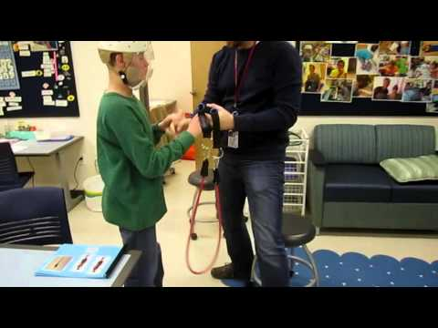
Video Work Samples (cont.)
This video shows a student and his teacher during an exercise routine. It’s a lengthy video (about 9 minutes), and you don’t need to watch the entire thing, but it should give you an idea of the range of competencies that can be demonstrated in a single video.
What competencies do you see this teacher demonstrating?
Video link

Slide 24
Video Work Samples (cont. )
You are encouraged to include as many video work samples as possible in your portfolio.
Submissions that contain videos score much higher than those that do not.
Submissions with multiple videos have a successful pass rate of greater than 75%.
Videos make complex ideas easier to understand: they clearly show processes and results, helping people grasp difficult concepts quickly.

Slide 25
Written Work Samples
A written work sample refers to a written product you created (either independently or in collaboration with others) to benefit your student or client. Examples include:
Completed data sheets
Notes home to parents explaining what a student did that day
Logs shared with other team members detailing a student’s activities
Teaching materials
Be sure to block out your student/client’s name and any other identifying information before including documents in your submission.

Slide 26
Assignments and Other
Learning Products
Coursework assignments and professional development and self-study products can be very helpful for demonstrating knowledge competencies.
Documentation from these items must show the attainment of specific knowledge and skills. Transcripts, syllabi, and certificates of attendance or completion are not sufficient.
Photo work samples
Video work samples
Written work samples
Completed coursework assignments
Professional development products
Self-study products
Performance evaluations
Reports of formal observations of the intervener

Slide 27

Assignments and Other
Learning Products (cont.)
Completed coursework assignments are those you completed as part of credit or noncredit classes through a community college, four-year college or university, or a state deaf-blind project intervener training program.
Professional development products are materials you created or wrote as a result of professional development activities (e.g., in-services, online workshops, face-to-face workshops, coaching sessions, consultation sessions).

Slide 28

Self-Study Products
These are written descriptions or illustrations you create based on independent reading or study, or knowledge gained from completing an online module or course without an instructor.
For example, you might write a summary of a journal article you've read (attaching the article itself is not sufficient documentation).

Slide 29
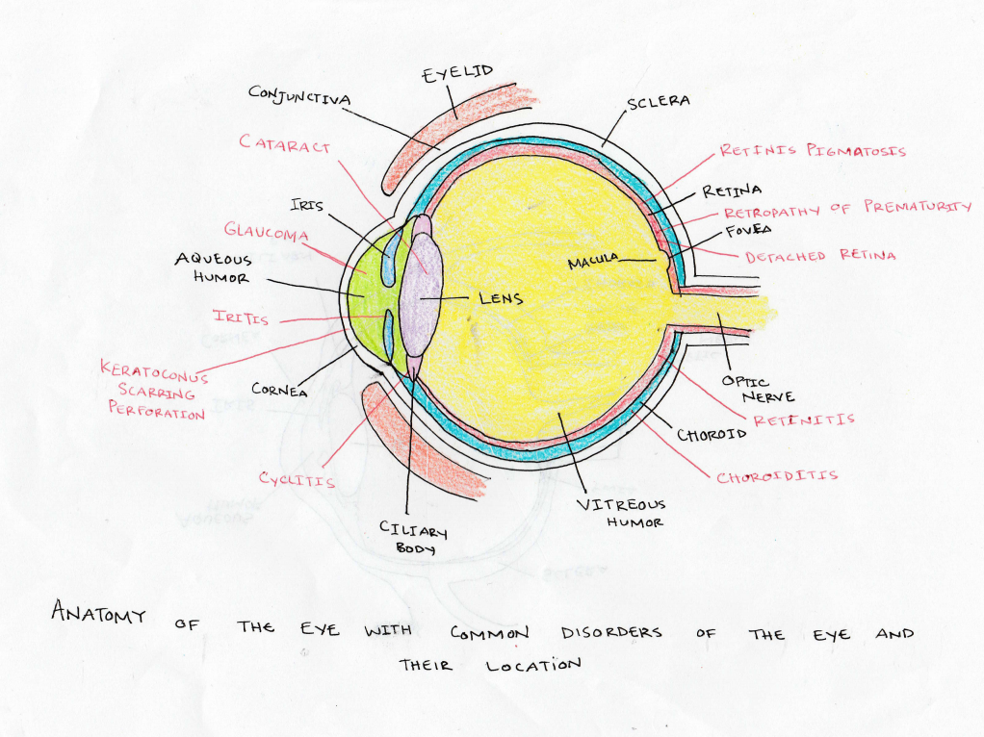
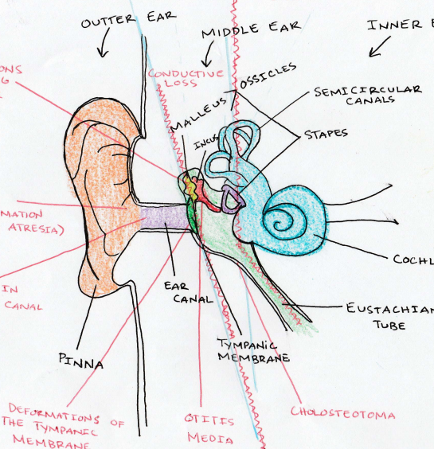
Self-Study Products (cont.)
Here’s an example where an intervener created diagrams of the anatomy of the ear and eye based on her own self-study.

Slide 30
Evaluations and Observations
Performance evaluations and observation reports are assessments of your competence made by others.
In your explanation of these items, you’ll need to include details that connect specific sections or statements from the evaluations or reports to the competencies you are targeting in the given artifact.
Photo work samples
Video work samples
Written work samples
Completed coursework assignments
Professional development products
Self-study products
Performance evaluations
Reports of formal observations of the intervener

Slide 31

Evaluations and Observations (cont.)
Performance evaluations are formal written reviews of your job performance, typically tied to a school district or other agency evaluation process.
A report of a formal observation refers to a written account, conducted by an expert in deaf-blindness, of you engaging in intervention with a student or client. For school interveners, these observations typically occur in educational settings, while for community interveners, they take place in home, work, or community settings.

Slide 32
Documentation Tips
You may use multiple types of documentation in a single artifact. For example, a combination of photographs and a written work sample might be the best fit for one artifact, while a completed coursework assignment may be more suitable for another.
You are not required to use all types of documentation in your portfolio. Different candidates will have access to varying types of documentation. The most important factor is selecting artifacts that effectively demonstrate your mastery of the competencies.
A single piece of documentation can serve as evidence for multiple artifacts. For instance, the 9-minute video you saw earlier showcased a broad range of skill competencies.

Slide 33

Documentation File Types
You can use a number of different file types for your documentation
YouTube or Vimeo videos
jpg, png, gif photos
Word documents
pdf documents
PowerPoint presentations
Excel spreadsheets

Slide 34
Artifact Questions
To provide context for your documentation, you will also be asked to respond to several questions in the artifact template:
The questions provide information such as:
In what settings was documentation depicting or related to a specific student collected?
In what settings was the documentation involving assignments or other study generated?
What level of collaboration was involved in activities depicted in the documentation?

Slide 35
Artifact Questions (cont.)
Your handout Documentation Information and Formats shows the responses from which you can choose for each of these questions.
Your answers to the artifact questions are not scored, but may give reviewers additional insight into your documentation.

Slide 36
Additional Information
Some artifacts are more complex to review than others. Often, pictures, videos, or work samples require additional context to be fully understood. To provide this context, there is a section titled “Additional Information” in your artifact template where you can include helpful details to strengthen your documentation.

Slide 37
Artifact Component 3:
Explanation

Slide 38
Explanations
The competencies and documentation are the first two pieces of the artifact puzzle. The third piece is your “explanation,” where you describe how the documentation you’ve provided demonstrates that you have met the competencies being addressed.
Think of the explanation as a link or bridge between the competencies and your documentation.

Slide 39
Explanations (cont. 1)
The following two prompts will help you write explanations for each artifact. You must respond to both:
Please list each competency and describe how you have demonstrated the specific knowledge or skill.
Describe and explain your documentation so your reviewer can understand it better. This is your opportunity to provide additional context for the documentation. Examples are: what are you doing with the client/student, what is the student doing, why did you select this documentation?

Slide 40
Importance of Explanation
Explanations help demonstrate that you understand and can meet the required standards. They show how your work aligns with the expectations for certification.
Explanations make it easier for reviewers to see how your evidence meets the certification requirements, increasing your chances of passing.
Writing out your thought process also shows that you are continuously learning and improving, which is key for professional recognition.
Explanations transform your videos, documents, and other evidence into a cohesive story about your skills and experience.

Slide 41

Self-Reflection
As you can see, the process of creating artifacts requires significant self-reflection, which forms the foundation of micro-credential development.
Reflecting on your knowledge and skills, finding documentation to demonstrate your competencies, and explaining the connections all require deep self-analysis and careful consideration of your practice as an intervener.
Sources: Butler, 2006; Kimball, 2005

Slide 42
Self-Reflection (cont.)
Self-reflection involves:
Carefully considering your goals, behavior, and beliefs.
Thinking critically about your actions in the classroom or other settings—why you do what you do, and why it is or isn’t effective
This process not only helps you create a portfolio that clearly demonstrates your competence as an intervener to reviewers, but also fosters professional growth by allowing you to recognize and build on your strengths while identifying areas for improvement in your practice.

Slide 43

Staying Organized
We suggest creating a dedicated folder on your computer or in the cloud specifically for storing your artifacts for each microcredential you choose to pursue.

Slide 44

For more information on Intervener Microcredentials and NICE certification, contact Dr. Ritu Chopra at the PAR²A Center
Ritu.Chopra@ucdenver.edu
https://paracenter.org/
Adapted from NICE Training Materials, 2017–2024. U.S. Department of Education Grant #H326T180026

