Slide 1



Portfolio Submission and Review

Slide 2
Have Your Handouts
The following slide deck will reference the following handouts:
Review Recommendation Form
Portfolio Submission Form
How to Compress Multiple Files for Portfolio Submission
Scoring Rubric

Slide 3
Portfolio Submission Process

Slide 4
Portfolio Submission Process: Step 1
When You Are Ready to Submit Your Microcredential Portfolio:
The Review Recommendation Form must be signed by both the candidate and the mentor to confirm that:
  Ethical guidelines and policies have been followed
  The candidate has received appropriate mentorship
The form should be submitted only after both the candidate and mentor agree that the portfolio is ready for review.
The mentor is responsible for sending the completed form to:
Dr. Ritu Chopra at ritu.chopra@ucdenver.edu

Slide 5
Portfolio Submission Process: Step 2
After Submitting Your Review Recommendation Form:
Within 72 business hours of submission, you will receive a unique link to:
  Register and pay for your portfolio submission
  Receive downloadable templates to help you create your portfolio and upload your required documents
  Provide additional information about your submission
Portfolio submissions are securely stored on Qualtrics, a protected platform monitored by the NICE team at the PAR²A Center. Each participant receives an individual upload link.
If you have any questions, please contact Dr. Ritu Chopra at the PAR²A Center: ritu.chopra@ucdenver.edu.

Slide 6
Portfolio Submission Process: Step 3
Once you have your unique Qualtrics link for submission, you must prepare your documents prior to beginning the upload.
The following items are included in your submission:
Portfolio Submission Form
About Me
2 Letters of Recommendation
Selected Artifact/s using the template provided by the PAR²A center
  The typical range of artifacts is 1 to 10 artifacts per portfolio, but remember, only 5 competencies per artifact.

Slide 7
Portfolio Submission Form
The Portfolio Submission Form serves as a table of contents for your submission, outlining the standards you are addressing and the artifacts you are including.
You will also be asked to complete two ungraded reflection questions:
How are the knowledge and skills within this standard important to your role as an intervener with your student/team?
How did completing the requirements of this standard help you grow as an intervener and as a member of the student/client team? As you reflect on this standard, what have you learned about yourself and your ability to be an intervener?

Slide 8
Compressing Files
Compressing, or “zipping,” files is an essential step in submitting your portfolio.
This process bundles your files into a single, smaller file, making it easier to transfer. Before submitting, be sure to compress all your work into one zipped file.
Review the handout How to Compress Multiple Files for Portfolio Submission for more explanation.

Slide 9
Qualtrics Submission
Once you have all your document ready, use the qualtrics link provided to you. Qualtrics will not allow you to more than the following 4 files or folders per section listed below :
Portfolio Submission Form
About Me
  About me form and training certificates. Certificates may be added as images into the document or compressed into one folder.
Two Letters of Recommendation
  May be combined as images, pdfs, or word files or compressed into one folder.
Artifact/s
  All artifacts must be in a single folder that is compressed. If there is only one artifact, it may be uploaded not compressed.

Slide 10
Submission File Types
Qualtrics will not allow you to upload anything other than:
PDF
Document
  DOC, DOCX, TXT, ODT
Spreadsheet
  CSV, XLS, XLSX, ODS
Graphic
  JPG, PNG, GIF

Slide 11
Overview of Review Process

Slide 12
NICE Reviewers
All reviewers have expertise in DeafBlindness and are members of the NICE Review Board.
As part of their agreement to serve as reviewers, all sign statements of confidentiality and impartiality.
All portfolios are reviewed by at least two reviewers

Slide 13
“About Me” Review
About Me Section – Reviewer Guidance
Reviewers will begin by carefully reading your “About Me” section to gain a foundational understanding of:
You as an individual
Your training and educational background
Your professional development experiences
The student(s) or client(s) you work with
This section appears at the very start of your submission and helps set the tone for the entire review process.
While this section is not scored, it plays a crucial role in helping reviewers better understand and contextualize your submitted artifacts.

Slide 14
Artifacts Review
After reviewing your “About Me” section, reviewers will proceed to evaluate your artifacts.
For each artifact, they will assess how effectively your documentation and explanations together demonstrate your mastery of the related competencies.

Slide 15
Artifact Scoring System
Artifacts are scored using a tool called the NICE Scoring Rubric.
This rubric is displayed on the next two slides, and you also have a copy with the same information available under “Important Documents.”

Slide 16
NICE Rubric for Documentation
Levels of Mastery
 | Advanced | Proficient | Emerging | No Evidence
Demonstration of CEC Competencies | All of the identified competencies are demonstrated. | A majority of the identified competencies are demonstrated. | Only a minority of the identified competencies are demonstrated. | None of the identified competencies are demonstrated.

Slide 17
“Demonstrated”
The rubric says “competencies are demonstrated”, what does that mean?
“Demonstrated” means that you, as the candidate, have provided documentation that clearly shows your correct application of skills or accurate understanding of the knowledge required by a specific competency. This evaluation is based on the professional judgment of the reviewer.

Slide 18
“Demonstrated” Cont.
Questions to consider when determining whether a competency has been demonstrated include:
If a skill competency:
  Does the documentation show the intervener in action applying the knowledge or skill or the result of having the knowledge or skill (e.g., development of instructional materials)?
  Is the documentation related to the intervener’s own practice (e.g., if demonstrating a skill, it should show actual interactions with the intervener’s student/client, rather than role playing)?
If a knowledge competency, does the documentation indicate that the intervener has acquired the knowledge?
Does the documentation provide sufficient detail to adequately assess whether a competency has been met?

Slide 19
Majority and Minority
The rubric says “a majority” or “a minority” of competencies, what does that mean?
Number of competencies in artifact | Majority means . . . | Minority means . . .
1 | The single competency is demonstrated/explained | No competencies are demonstrated/explained
2 | Both competencies are demonstrated/explained | No competencies are demonstrated/explained
3 | 2 of the 3 competencies are demonstrated/explained | Only 1 competency is demonstrated/explained
4 | 3 of the 4 competencies are demonstrated/explained | Only 1 competency is demonstrated/explained
5 | 3 to 5 of the competencies are demonstrated/explained | Only 1 or 2 competencies are demonstrated

Slide 20

Reviewer Written Feedback
In addition to providing a score, reviewers will also provide written feedback about your artifacts that will be shared with you at the end of the review process.

Slide 21
Overall Score
Once reviewers have assigned a score to every artifact, all of the artifact scores are averaged and converted to a percentage score for the overall submission.
To obtain a microcredential, you must receive an overall passing score of 75% or greater.
Score | Mastery Level
<50% | No evidence
50-74% | Emerging
75-89% | Proficient
90-100% | Advanced

Slide 22

Getting Your Results
The review process typically takes two to three months.
This allows time for The PAR²A Center to check the reviewers’ scores for accuracy, assess the level of agreement between the two reviewers, and assign a third reviewer if necessary

Slide 23
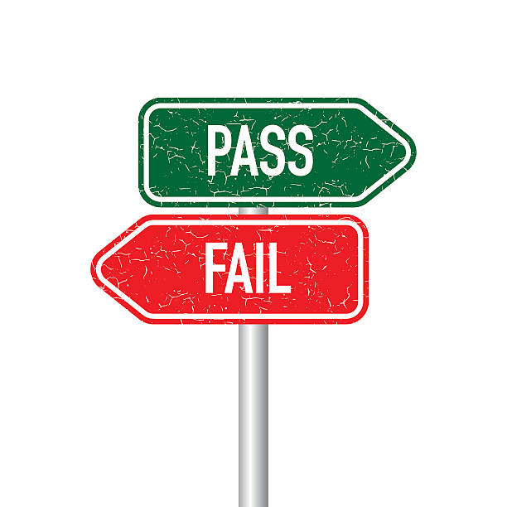
Getting Your Results (cont.)
Once the process is complete, you will receive:
A pass/fail score
The reviewers’ written feedback
Your certificate, if you have passed
If you do not pass, you may revise and resubmit your work once at no cost.

Slide 24

For more information on Intervener Microcredentials and NICE certification, contact Dr. Ritu Chopra at the PAR²A Center
Ritu.Chopra@ucdenver.edu
https://paracenter.org/
Adapted from NICE Training Materials, 2017–2024. U.S. Department of Education Grant #H326T180026

