Slide 1
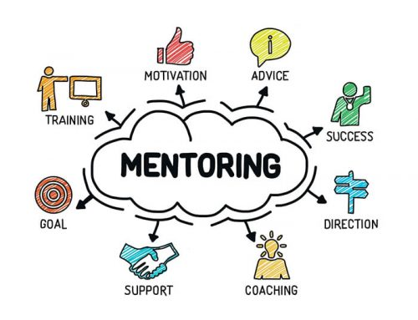


Effective Mentoring

Slide 2
Mentor: “a trusted counselor or guide.”
Merriam-Webster’s online dictionary

Slide 3
Setting you up for Successful
Research indicates that successful e-portfolio implementation requires that participants:
Clearly understand the purpose and value of constructing a portfolio
Receive comprehensive and well-defined guidelines throughout the process
Have access to a flexible, user-friendly electronic portfolio system

Slide 4
The Need for Support
Participants also require the support of dedicated mentors.
Mentors who are actively engaged in the portfolio process and provide consistent, relevant guidance and feedback are widely recognized as essential to the success of e-portfolio initiatives.

Slide 5
Origins of Mentoring
The word mentor originates from Greek mythology.
In Homer’s Odyssey, Mentor was a trusted teacher and advisor to Telemachus, the son of Odysseus.
The topic of mentoring was introduced in an earlier learning activity. In this learning activity, we revisit key points to ensure that both the mentor and mentee have a clear understanding of their respective roles.

Slide 6
The Role of the Mentor
The role of a NICE mentor is to provide support, suggestions, and encouragement to the candidate, but not be involved in the actual creation of the portfolio (e.g., writing, editing, submitting materials to).
In the portfolio process, a mentor:
Serves as a facilitator and guide during the construction of the portfolio
Monitors the mentee’s progress and learning
Offers feedback and encourages further action when appropriate
Provides the guidance and support needed to enable the mentee to successfully complete the portfolio process

Slide 7

Working with a Mentor

Slide 8
Working With a Mentor
Submitting your portfolio for a microcredential is a meaningful and substantial undertaking—but you won’t be doing it alone.
Your mentor will be there to guide and support you every step of the way. Here are a few key ways they can assist:
Engage in thoughtful discussions and provide encouragement as you explore the NICE materials and CEC standards
Help you clarify your goals and develop a realistic, achievable timeline
Offer ongoing feedback on your artifacts, highlighting strengths and suggesting areas for improvement
Review and provide input on your “About Me” section to ensure it reflects your voice and vision

Slide 9

Working With a Mentor (cont.)
Establish clear methods of communication with your mentor—such as phone calls, Skype, Google Hangouts, or in-person meetings.
At a minimum, mentors are required to meet with candidates at least three times, totaling a minimum of six hours of mentoring.
The next few slides outline the roles and responsibilities of both candidates and mentors to help you build a strong and effective working relationship. Review the handout Candidate-Mentor Relationship for further detail.

Slide 10
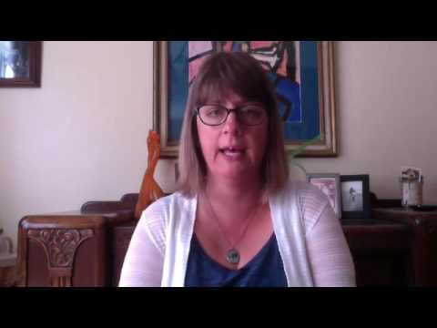
The Role of the Mentor (cont.)
Julie Maier, Educational Specialist for California Deafblind Services, describes the role of a mentor in the NICE process.

Slide 11
MENTORS
Qualifications/Role | Responsibilities | Relationship
Has training in deaf-blindness and is familiar with the intervener model Supports the candidate in understanding the CEC competencies and how they apply to the microcredentialing process. | Review and discuss the Intervener Microcredential Policy and Procedures and Candidate-Mentor Relationship with the candidate Assist in creating an e-portfolio development plan and timeline Hold regular meetings to monitor progress, offer feedback and encouragement | Adapt mentoring style to match the strengths and needs of the candidate Build a connection with the candidate Help the candidate “tell their story” their way

Slide 12
MENTORS (contd.)
Qualifications/Role | Responsibilities | Relationship
Encourages the candidate to engage in reflective self-assessment Models reflection by sharing relevant personal experiences | Communicates in ways that align with the candidate’s needs and preferences Notifies the candidate and relevant partners promptly if unable to provide agreed-upon mentoring Submits the Review Recommendation Form when the candidate is ready | Respects the candidate’s confidentiality, including their portfolio content Provides encouragement and professional support throughout the process

Slide 13
CANDIDATE
Qualifications/Role | Responsibilities | Relationship
Has received intervener training and is serving a student who is deaf-blind | Review and discuss the Intervener Microcredential Policy and Procedures and Candidate-Mentor Relationship with the mentor Create and share portfolio artifacts with your mentor and incorporate your mentor’s feedback Use the explanation prompt questions to guide conversations about artifacts | Is willing to be coached and open to constructive criticism as well as praise Professional and respectful of the mentor’s time and expertise

Slide 14
CANDIDATE (cont.)
Role | Responsibilities | Relationship
Engages in conversations with the mentor about all aspects of e-portfolio development | Take responsibility for the process and engage in reflective self-assessment Keep appointments and communicate any concerns or timeline/submission challenges with your mentor Maintain the confidentiality of your student or client | Is willing to be coached and open to constructive criticism as well as praise Professional and respectful of the mentor’s time and expertise

Slide 15
Getting Started with Your Mentor
Now that you have a basic understanding of the roles and responsibilities of both the mentor and candidate, it's time to complete two important forms:
Candidate Information Form
Mentor Information Form
These forms are designed to support clear communication and help build a strong, collaborative relationship between you and your mentor.

Slide 16

Mentor DOs
Accept your mentee as a fellow professional.
Respond to communications in a timely manner.
Discuss e-portfolio tasks and scoring rubrics clearly.
Provide feedback focused on selecting the strongest documentation to demonstrate competency achievement.
Respect diversity -remember that you and your mentee may have different backgrounds and perspectives.
Ask probing questions about the mentee’s responses and artifacts without directly writing or editing their work.
Use open-ended questions to foster meaningful dialogue and reflection.

Slide 17
Ask Open-Ended Questions
A key strategy for encouraging reflective thinking is to ask thoughtful questions. Consider prompts such as:
How do you think the activity went?
In what ways did the student meet or not meet their learning goals?
How do you know?
How might you follow up on this activity?

Slide 18
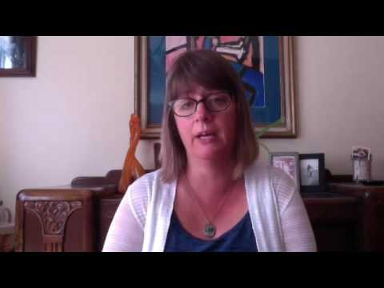
Individualized Approach
Julie talks about the importance of recognizing the uniqueness of each intervener.

Slide 19

Mentor DON’Ts
Do not provide feedback that includes specific alternative responses.
Do not direct candidates on which artifacts to select for submission.
Do not edit a mentee’s documentation or e-portfolio content directly.
Do not upload documentation into the e-portfolio on the candidate’s behalf.

Slide 20
Mentor Expectations
Commit to a minimum of three meetings with the candidate, providing at least six hours of support and feedback in total.
Review the candidate’s “About Me” section and portfolio artifacts thoroughly.
Provide timely, constructive feedback on the candidate’s progress and materials.
If any concerns or questions arise regarding the mentor role or the mentoring relationship, promptly communicate with the State Deaf-Blind Project, university partner, or PAR²A Center.

Slide 21
Mentor Expectations (cont.)
Be a positive and encouraging source of support.
Maintain balanced communication that is friendly, respectful, and professional.
Practice active listening, paying close attention to any issues or concerns.
Regularly check in by asking, “What are your thoughts about this process and our work together? Is it working for you?”

Slide 22
The Effective Mentor
Effective mentors are:
Active listeners who genuinely engage with their mentees
Readily available and responsive to their mentees' needs
Genuinely invested in building a strong mentoring relationship
Knowledgeable about the mentee’s strengths, growth areas, and potential
Skilled at motivating mentees to set goals and challenge themselves appropriately
Source: Ramani, Gruppen, & Kachur, 2006

Slide 23
The Effective Mentor (cont.)
Effective mentors:
Provide both positive feedback and constructive criticism rather than negative feedback
Balance encouragement with appropriate levels of challenge
Demonstrate respect for cultural, gender, and generational differences
Maintain confidentiality and uphold trust
Establish and respect professional boundaries
Regularly check in with mentees to ensure their needs are being met
Source: Ramani, Gruppen, & Kachur, 2006

Slide 24
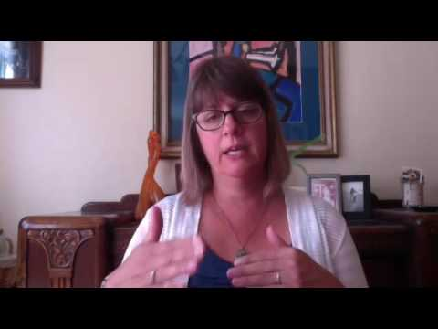
Building Relationships

Slide 25
Verification of Mentorship
Before submitting the portfolio, candidates must complete the Review Recommendation Form to certify that they have received mentorship.
This form also requires the mentor to confirm that they have supported the candidate’s portfolio development in alignment with the ethical guidelines of their role.
You’ll explore this process in more detail in Learning Activity 4: Portfolio Submission and Review.

Slide 26
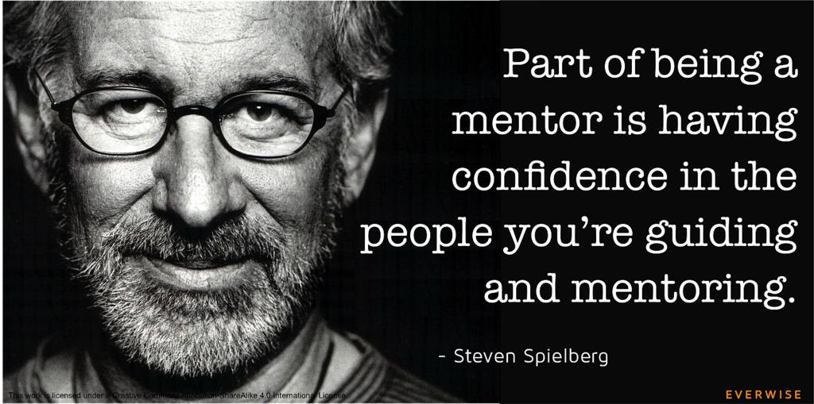

Slide 27

For more information on Intervener Microcredentials and NICE certification, contact Dr. Ritu Chopra at the PAR²A Center
Ritu.Chopra@ucdenver.edu
https://paracenter.org/
Adapted from NICE Training Materials, 2017–2024. U.S. Department of Education Grant #H326T180026

